Slide 1
Moving to Berlin
A Neighbourhood Guide for Newcomers to Berlin

Slide 2
Determining the right neighbourhood is important for new employees
Living in an unsuitable neighbourhood can have an impact on overall happiness and work performance.
Visiting a city as a tourist gives an incomplete picture of life as a resident.
Worst-case scenario: an employee may quit, causing a company to waste time and money recruiting for the role again.

Slide 3
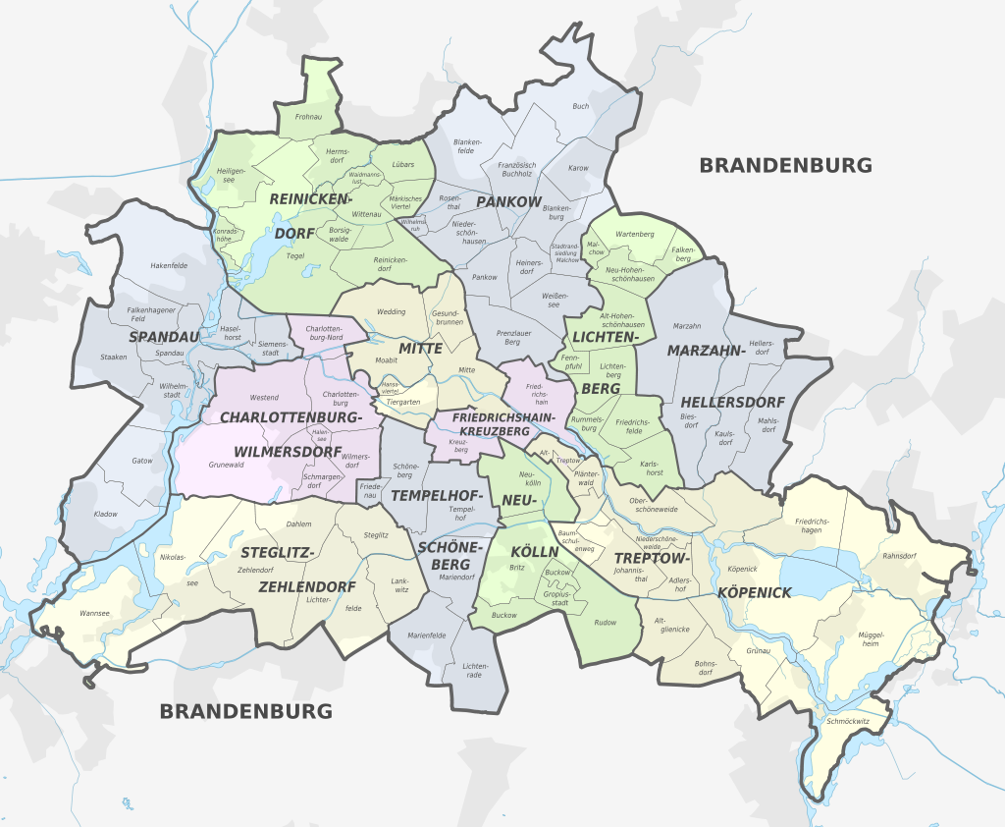
Data
A list of 96 neighbourhoods was collected from Wikipedia.
Combined with location data from Geocoder
Venue data acquired from the Foursquare API – 2435 venues across 292 unique venue categories.

Slide 4
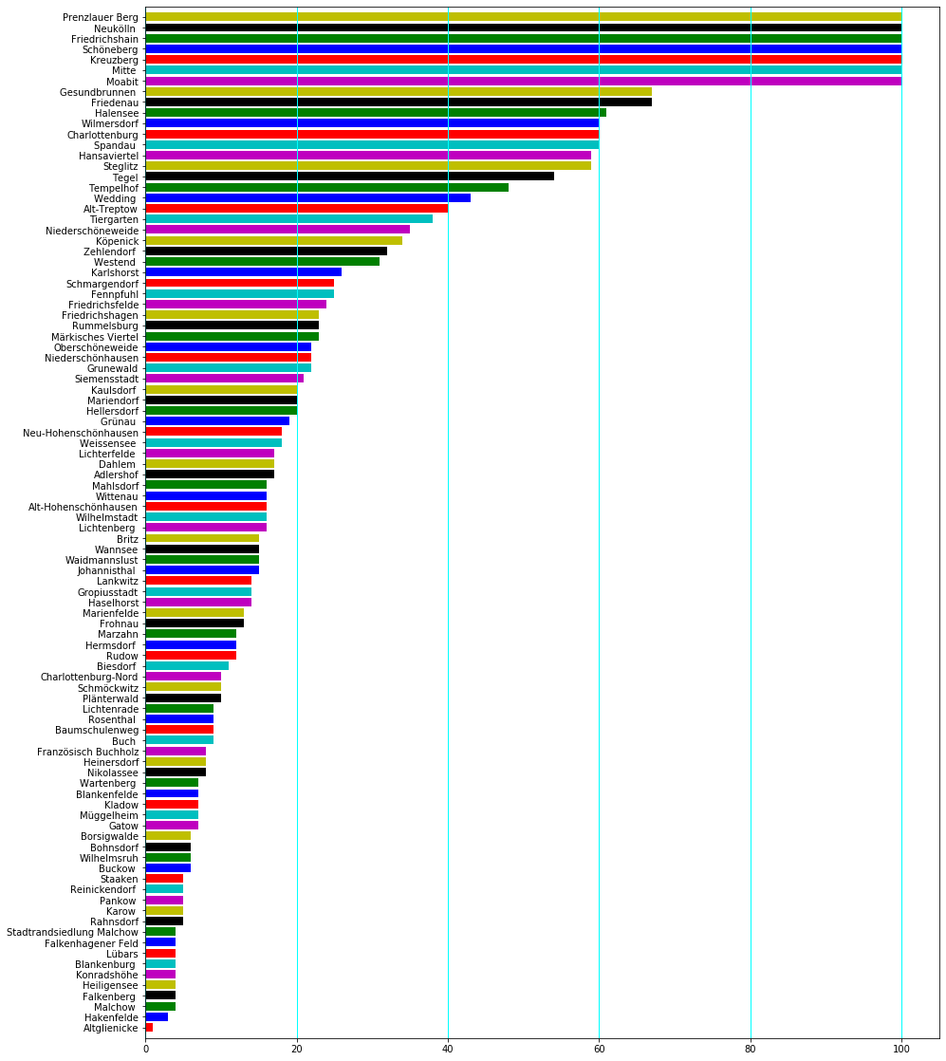
Great range of the number of venues in each neighbourhood
More venue, more accurate clustering will be.

Slide 5
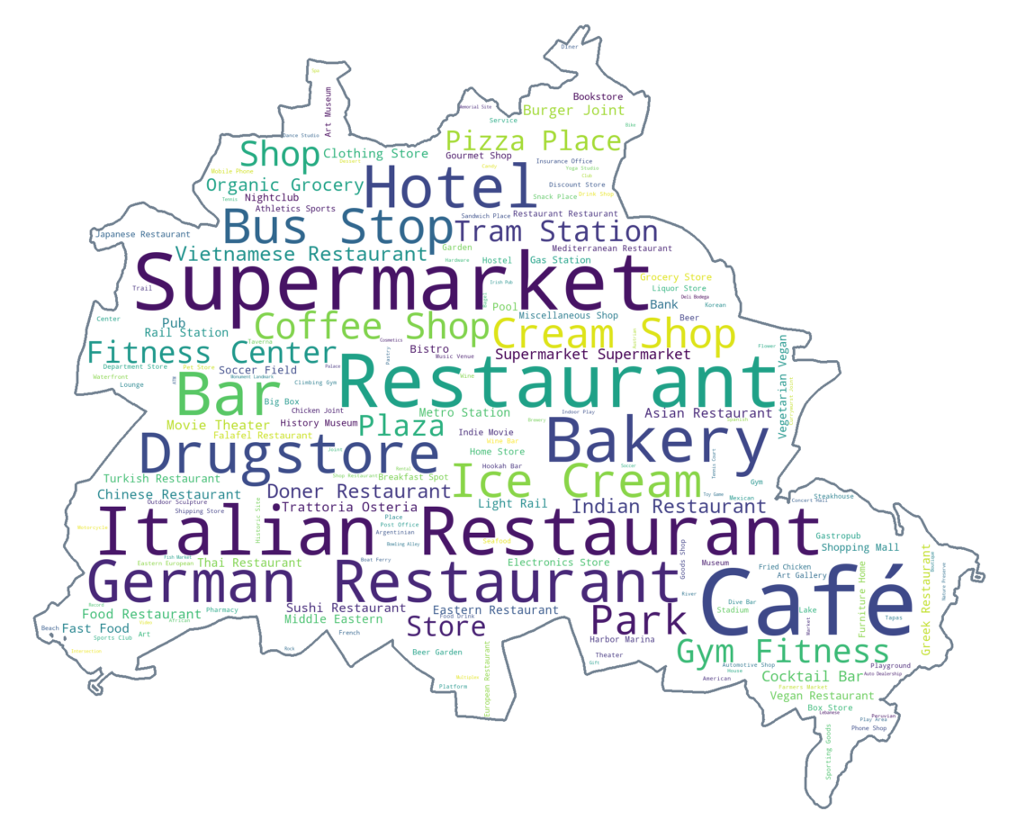
Great range of venue categories across the city
Café, Restaurant, Supermarket, Italian Restaurant, Bakery are the most abundant

Slide 6
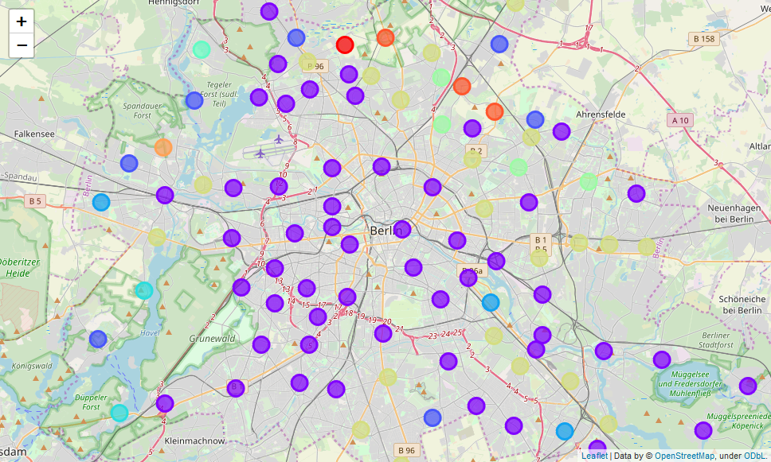
Two Distinct Areas – Inner & Western Outer & Eastern

Slide 7
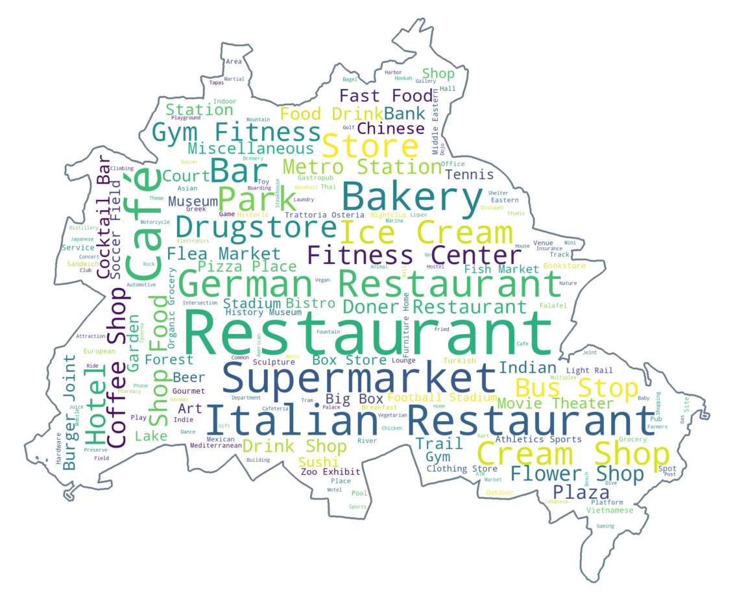
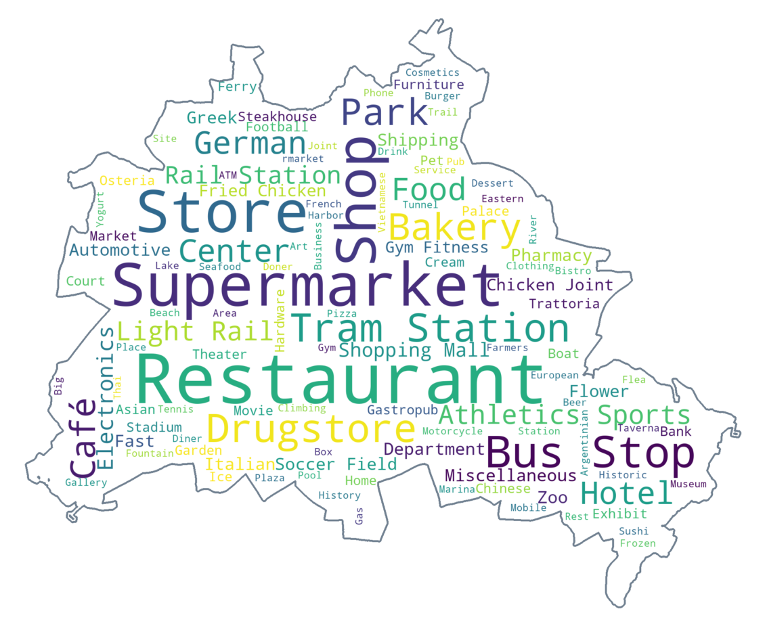
A greater range of venues in Inner & Western Berlin
Inner & Western
Outer & Eastern
More bars, cafés and restaurants suggest livelier neighbourhoods

Slide 8
Conclusion & Future Directions
Western & Inner Berlin livelier, greater variety of things to do
Eastern & Outer Berlin quiet, fewer things to do
Future:
More complete data source for outer Berlin Neighbourhoods
Show relationship between venue categories
i.e. Restaurant > Japanese Restaurant > Sushi Restaurant

